Slide 1




NEXT GEN EMPLOYABILITY PROGRAM
Creating a future-ready workforce
Team Members
College Name
Student Name : A.Adelin Brianna
Student ID :au311121104001
Loyola ICAM-College of Engineering and Technology

Slide 2

CAPSTONE PROJECT SHOWCASE
Project Title
Music Web Application using Django Framework
Abstract | Problem Statement | Project Overview | Proposed Solution | Technology Used | Modelling & Results | Conclusion

Slide 3
Abstract
This project aims to create a Music Web Application using the Django Framework. The application will allow users to discover, listen to, and manage music tracks. It will provide a user-friendly interface for browsing music genres, creating playlists, and accessing music recommendations. The application will also include features for user registration, authentication, and profile management.
Source :

Slide 4
Problem Statement
The current music streaming services lack a personalized and user-friendly interface for discovering and managing music tracks. Users often face difficulties in finding music that suits their preferences and creating playlists that cater to their tastes. Additionally, existing platforms may not offer seamless integration with social media or lack features for music exploration based on mood or activity.
To address these challenges, our project aims to develop a Music Web Application using the Django Framework. This application will provide users with a platform to discover, listen to, and manage music tracks easily. It will offer personalized music recommendations, intuitive playlist creation and management features, and a user-friendly interface for browsing music by genre, artist, or mood.
By developing this Music Web Application, we aim to create a solution that enhances the music listening experience for users, providing them with a platform that is both engaging and easy to use.
Source :

Slide 5
Project Overview
The Music Web Application will consist of several key components:
User Authentication: Users will be able to register, log in, and manage their profiles.
Music Library: The application will have a database of music tracks with information such as title, artist, genre, and album.
Search and Browse: Users can search for music by title, artist, or genre. They can also browse music by genre.
Playlists: Users can create, edit, and delete playlists. They can add tracks to playlists and reorder tracks within playlists.
Recommendations: The application will provide music recommendations based on user preferences and listening history.
Audio Player: Users can play music tracks directly within the application. The player will have controls for play, pause, skip, and volume.
Source :

Slide 6
Proposed Solution
Database Design: Use Django's ORM to create models for music tracks, genres, albums, artists, playlists, and user profiles. Use relational databases like SQLite or PostgreSQL.
User Authentication: Use Django's built-in authentication system for user registration, login, logout, and password management.
Frontend Design: Use HTML, CSS, and JavaScript to create a responsive and user-friendly interface. Use Django's template system to render frontend views.
Audio Player: Use a JavaScript library like Plyr or Wavesurfer to create an audio player for playing music tracks.
Recommendation System: Use machine learning algorithms to analyze user preferences and listening history to provide personalized music recommendations.
Deployment: Deploy the application to a web server using a platform like Heroku or AWS. Ensure scalability and performance by optimizing database queries and frontend assets.
Source :

Slide 7


Technology Used
Front-end
Back-end
Source :

Slide 8
Modelling & Results
Modelling:
Database Schema: User, Music Track, Playlist, Genre models.
Views and Templates: User registration, login, profile management, music browsing, playlist creation/editing.
Audio Player: JavaScript library for play, pause, skip, volume controls.
Optional: Recommendation System using ML for personalized music suggestions.
Results:
User Registration and Authentication.
Music Browsing by title, artist, genre.
Playlist Creation and Management.
Customizable Audio Player.
Optional: Personalized Music Recommendations.
Source :

Slide 9
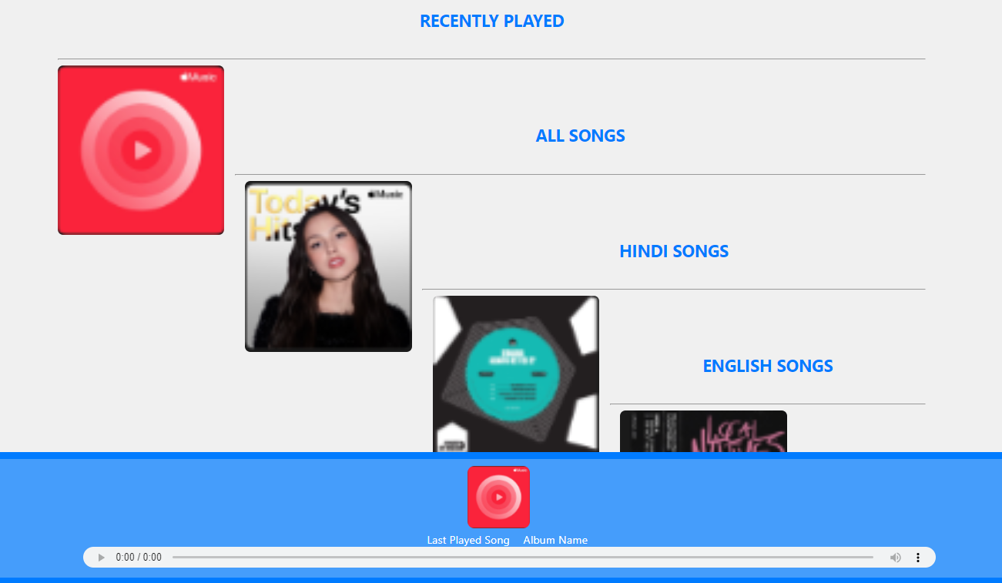
Homepage

Slide 10
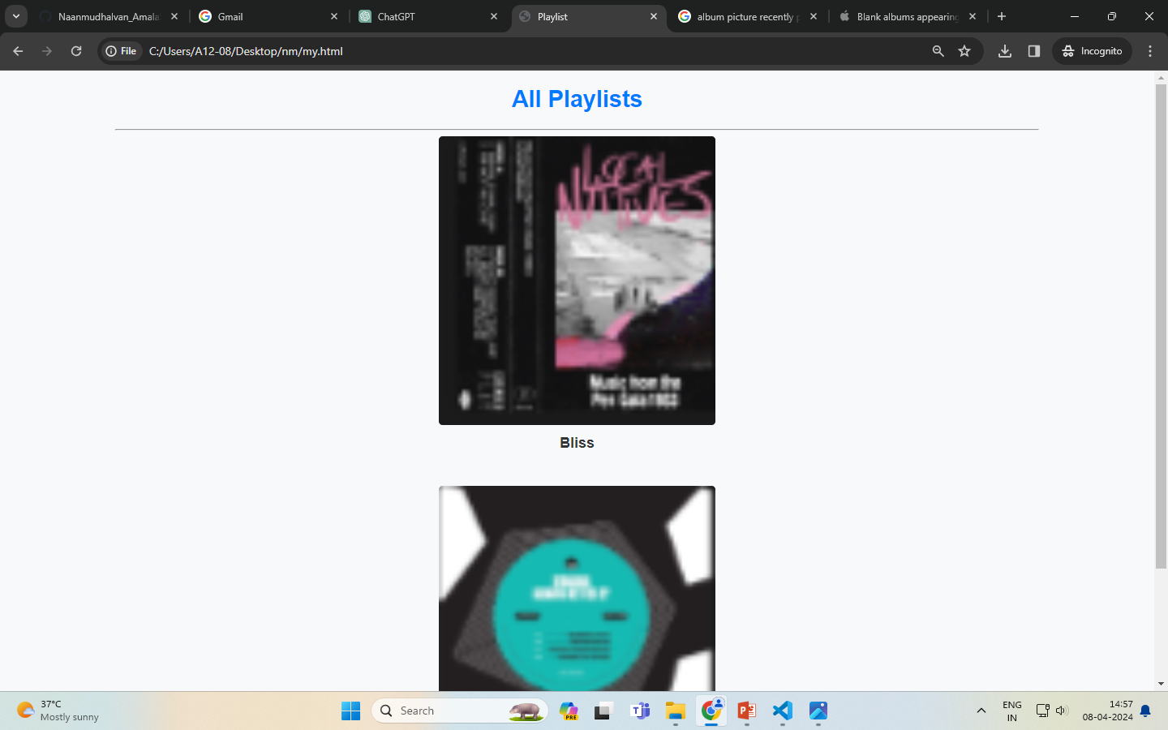
Index-Page

Slide 11
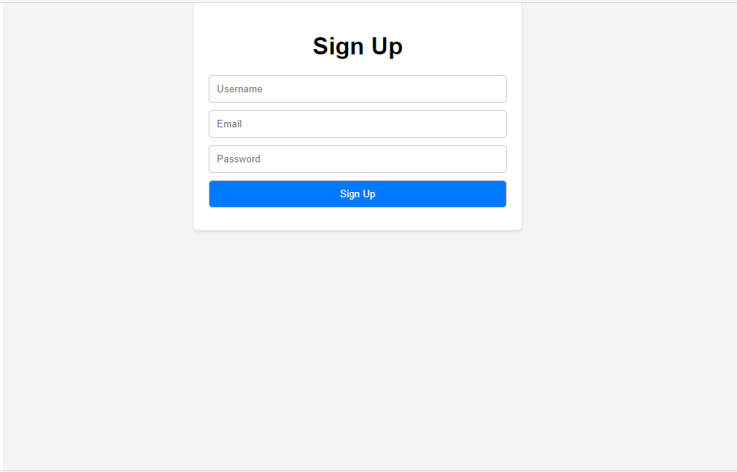
Sign in-Page

Slide 12
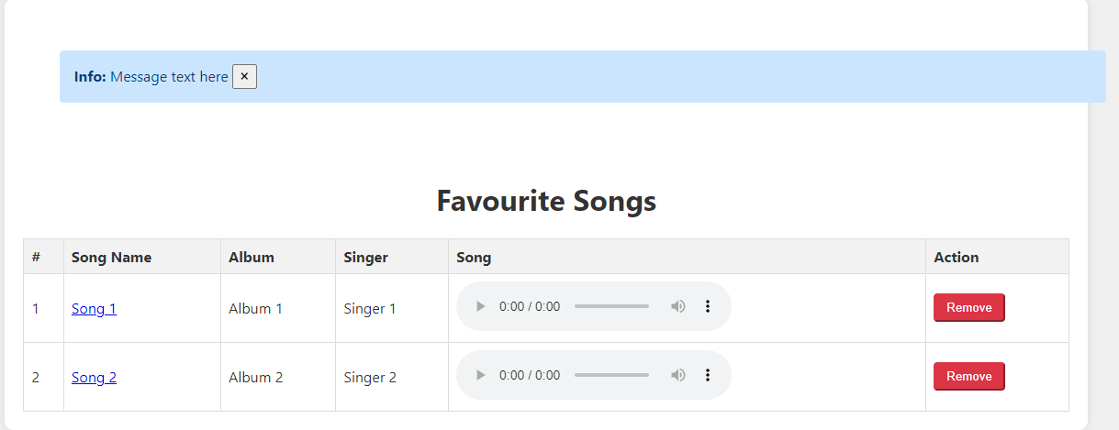
Favorites Playlist-Page

Slide 13
Future Enhancements:
1. User Authentication: Implement user authentication to allow users to create accounts, log in, and manage their profiles.
2. Music Upload: Allow users to upload their own music files to create personal playlists or share with others.
3. Music Recommendations: Implement a recommendation system to suggest new music based on user preferences and listening history.
4. User Interactions: Enable users to like, comment on, and share songs or playlists.
5. Social Media Integration: Integrate social media platforms to allow users to share music and playlists with their friends.
6. Music Player Controls: Enhance the music player with features like shuffle, repeat, volume control, and progress bar.
7. Personalized Recommendations

Slide 14
Conclusion
In conclusion, by incorporating user authentication, music upload functionality, recommendation systems, social media integration, enhanced player controls, improved search and filter options, responsive design, playlist collaboration, and personalized recommendations, your music web application can become a comprehensive and engaging platform for music lovers. These features can help create a seamless and personalized experience for users, enhancing their ability to discover, share, and enjoy music.
Source :

Slide 15
Thank You!
Notes:
Thank You !!

